Slide 1

Network Security Assessment and Monitoring Tool
CYBERSECURITY PROJECT
Student
Snehal Teli
Institute
IT Vedant
Course
Cybersecurity and Ethical Hacking
Notes:
Good morning. My name is Snehal Teli, and I study Cybersecurity and Ethical Hacking at IT Vedant. My project is called the Network Security Assessment and Monitoring Tool. In simple words, it is a Python tool that checks which doors (ports) are open on a computer, remembers the result, and tells me when something changes. I will explain how it works, show you screenshots from my Kali Linux demo, and talk about what it can and cannot do.

Slide 2





What Is Network Security Monitoring?
How my tool works
In simple words
1. Scan
Network security monitoring means checking a system again and again to see which ports are open and what has changed since the last check.
Find which ports are open on the target.
2. Compare
Practical example
Match today's scan with the previous one.
Yesterday: no web server port was open.
Today: port 8080 is open because a test server started.
Result: the tool notices the change and records an alert.
3. Alert
Write any change into the alert log.
Notes:
Network security monitoring just means watching a system regularly. Think of a house with many doors. Each door is a port. If a new door suddenly opens, you want to know. My tool does three simple things: it scans to find open ports, it compares the new scan with the old scan, and it writes an alert when something changes. The example on the left shows this: yesterday no web port was open, today port 8080 is open, and the tool records the change.

Slide 3

Problem Statement and Objectives
Problem Statement
Objectives
Open ports can expose services that nobody notices.
Checking ports by hand is slow and easy to forget.
If changes are not written down, they are quickly lost.
1
Scan a system to find open ports
2
Give each open port a preliminary risk lable
3
Compare scans to find changes
4
Record alerts in a log file
This project: a tool that scans, compares and records.
5
Create a simple text security report
Notes:
The problem is simple. Computers can have open ports that nobody knows about, and each open port is a possible way in. Checking ports by hand takes time, and people forget to do it. Also, if a change is not written down, nobody can look back later. My objectives were to build a tool that finds open ports, gives a basic risk label, compares scans, records alerts, and creates a simple text report. Please note: this is a learning project, and the tool should only be used on my own system or a system I have permission to test.

Slide 4






Technologies Used
Python
Kali Linux
Socket Programming
The main language. It runs the scanner and the monitoring tool.
The operating system used to build and test the project.
Lets Python try to connect to a port to see if it is open.
JSON
File Handling
Network Monitoring
A simple text format used to store saved scan data.
Reads and writes result files, the alert log and reports.
Checking the same system again and again to see what changed.
Notes:
These are the tools I used. Python is the main language for the whole project. I worked on Kali Linux, which is a popular system for cybersecurity learning. Socket programming is how Python tries to connect to a port: if the connection works, the port is open. JSON is a simple way to store the scan results so I can compare them later. File handling lets the tool write results, alerts and reports to files. Network monitoring is the idea of checking again and again to see what changed.

Slide 5
Project Architecture and Workflow
MODULE 1
1
2
3
4
Port Scanner
Enter your own target IP
Scan the configured ports
Find the open ports
Add a preliminary risk label
scanner/port_scanner.py
Results are saved, then used by Module 2
MODULE 2
5
6
7
8
Change Detector
Save the scan results
Compare with the previous scan
Find new or no-longer-detected ports
Write alerts and a text report
monitoring/change_detector.py
Files created by the tool
Key idea
logs/scan_results.txt scan results
alerts/alerts.log alert log
Change detection compares the current scan with the previous saved scan.
Notes:
This slide shows how the project works from start to finish. There are two modules. Module 1 is the port scanner, in the file port_scanner.py. I enter my own IP address, the tool tries each configured port, finds the open ones, and adds a basic risk label. Module 2 is the change detector, in change_detector.py. It saves the results, compares them with the previous scan, finds new ports or ports that are no longer detected, and writes alerts. Results go into text files such as scan_results.txt and alerts.log. The main idea is simple: current scan versus previous scan.

Slide 6
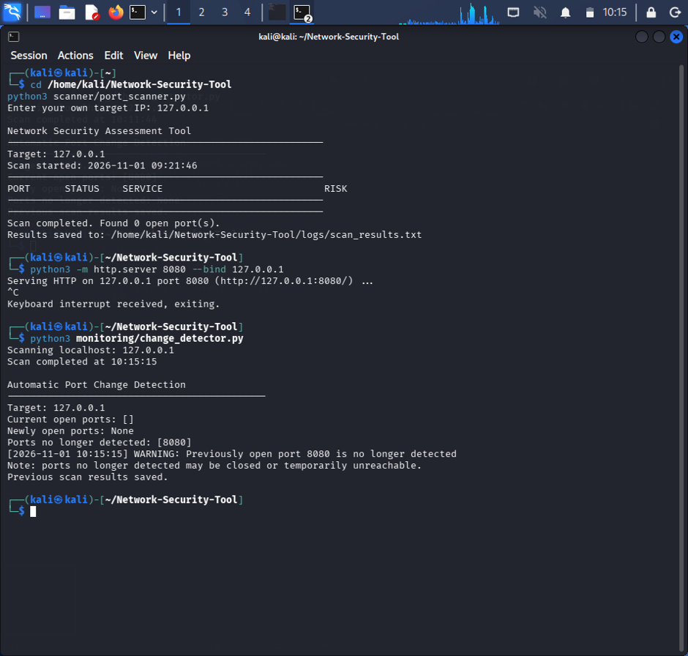
Module 1: Port Scanning
What is a port?
A port is like a door on a computer. An open port means a program is listening there.
What the scanner shows
Scans the configured ports
Lists open ports with PORT, STATUS, SERVICE and RISK
Saves results to a text file
Screenshot: scanner run on 127.0.0.1 (my own computer). No test server was running, so it found 0 open ports.
1
Enter your own target IP
2
Try each configured port using a socket
3
Open ports are listed with their service
4
A preliminary risk label is shown
Notes:
This is the first module, the port scanner. A port is like a door on a computer, and an open port means a program is listening behind that door. The screenshot is from my Kali Linux terminal. The tool asks me to enter my own target IP, so it is only used on my own system. Here I used 127.0.0.1, which is my own computer. The tool scans the configured ports and shows a table with PORT, STATUS, SERVICE and RISK. In this run no test server was running, so it correctly found 0 open ports. The result is also saved in a text file.

Slide 7
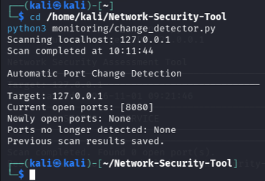


Module 2: Network Change Detection
Demo steps
1
Start a local test server on port 8080
python3 -m http.server 8080 --bind 127.0.0.1
2
Run the change detector
python3 monitoring/change_detector.py
3
Read the result: 8080 is in Current open ports
How the comparison works
Newly open port: open now, not in the previous scan
Screenshot: change detector run while the local test server was running. Port 8080 is listed as open.
No longer detected: open before, not found now
Why does it say 'Newly open ports: None'? Port 8080 was already saved from an earlier run. The first time it appeared, the tool logged 'Newly detected open port 8080' .
Notes:
The second module is network change detection. For the demonstration I started a small test web server on my own computer, using port 8080. Then I ran the change detector. In the screenshot you can see that Current open ports shows 8080, so the tool detected the open port. The tool works by comparing the current scan with the previous saved scan. If a port is open now but was not there before, it is a newly open port. If a port was open before but cannot be found now, it is no longer detected. In this particular screenshot, Newly open ports says None because 8080 was already saved from an earlier run. The first time it appeared, the tool logged it as newly detected, and you can see that in the alert log on the next slide.

Slide 8
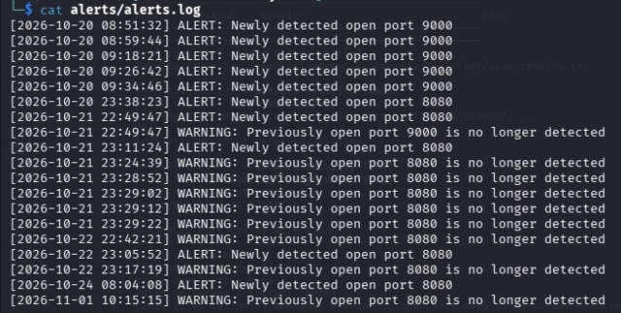


Alert System and Security Report
ALERT
A new open port was found, for example 'Newly detected open port 8080'.
WARNING
A port that was open is no longer detected. It may be closed or unreachable.
Screenshot: alerts/alerts.log. Green box: an ALERT for port 8080. Amber box: today's WARNING after the test server was stopped.
Text security report: the report summarizes the scan results and alert information that the tool has recorded, in a simple text file.
Notes:
Every time the change detector finds something, it writes a line into the alert log with the date and time. There are two kinds of lines. An ALERT means a newly detected open port. A WARNING means a port that was open before is no longer detected, and that could mean it was closed or just unreachable. The screenshot shows my alerts.log file. The green box is an alert for port 8080 being newly detected. The amber box is the warning from today, after I stopped the test server. The tool can also create a simple text security report, which summarizes the scan results and alert information that were recorded.

Slide 9
Project Results and Risk Assessment
No test server running
The scanner found 0 open ports on 127.0.0.1.
Test server started
Port 8080 was detected as open.
Test server stopped
Port 8080 was reported as no longer detected, and a warning was logged.
Screenshot: after the test server was stopped, port 8080 is no longer detected.
Risk assessment: each open port gets a label from predefined port-based rules. This is only a preliminary guide. It does not prove a system is safe or vulnerable.
Notes:
Here are the results of my demonstration, in order. First, with no test server running, the scanner found 0 open ports. Second, when I started the local test server, port 8080 was detected as open. Third, when I stopped the server, the change detector reported that port 8080 is no longer detected and wrote a warning in the alert log. The screenshot shows this last step. About risk assessment: the tool uses predefined rules based on the port number to give each open port a risk label. This is only a preliminary guide. It does not mean the system is definitely safe or definitely vulnerable.

Slide 10

Advantages and Limitations
Advantages
Limitations
Easy to understand and run
Repeats port checks without manual work
Shows what changed between scans
Keeps a history in the alert log
Built with free tools: Python and Kali Linux
Checks only the configured ports
Risk labels are preliminary and rule-based
Not a full vulnerability scanner or penetration test
Does not block attacks (no intrusion prevention)
Not an enterprise-grade monitoring system
'No longer detected' may mean closed or unreachable
Notes:
Advantages first. The tool is easy to understand and run, so it is good for learning. It repeats port checks without manual work, shows what changed between scans, and keeps a history in the alert log. It uses only free tools. Now the limitations, and I want to be honest about them. It only checks the ports that are configured. The risk labels are preliminary and based on simple rules. It is not a full vulnerability scanner and not a penetration testing tool. It does not block attacks, so it is not intrusion prevention, and it is not an enterprise-grade monitoring system. Also, when a port is no longer detected, it may be closed or just unreachable.

Slide 11






Future Scope
Ideas for future improvement
Web dashboard
Email alerts
More ports and targets
Show scan results and alerts on a web page.
Send a message when a change is found.
Scan a wider range of ports and several systems.
Service version detection
Vulnerability checking
Charts and history
Show which software version is running on a port.
Compare findings with lists of known weaknesses.
Draw graphs of how open ports change over time.
Notes:
These are ideas for the future. None of them are part of my current project, and I want to make that clear. With more time, I could add a web dashboard to show results on a page, email alerts when something changes, and scanning of more ports and more systems. I could also show service versions, compare findings with known weaknesses to do real vulnerability checking, and draw charts to show how open ports change over time.

Slide 12
Conclusion
Using Python, this tool scans ports, spots changes between scans and records alerts.
Implemented features
Thank You
Python-based port scanning
Preliminary port-based risk assessment
Snehal Teli
Network change detection
Detection of newly open ports
IT Vedant
Cybersecurity and Ethical Hacking
Detection of ports no longer detected
Alert logging
Continuous monitoring
Text-based security report generation
Notes:
To conclude: my project is a Python-based tool that scans ports, gives a preliminary risk label, detects changes, finds newly open ports and ports that are no longer detected, records alerts in a log, supports continuous monitoring, and creates a text-based security report. These eight features are what I actually built and demonstrated. It is a learning project and I am not claiming it is a full vulnerability scanner or an enterprise security product. Thank you for listening. I am happy to answer any questions.

